Slide 1
Model-2
Three phase Induction motors:
Review of concept and generation of rotating magnetic field, Principle of operation, construction, classification and types; squirrel-cage, slip-ring (No question shall be set from the review portion). Slip, Torque equation, torque-slip characteristic covering motoring, generating and braking regions of operation, Maximum torque, significance of slip.

Slide 2
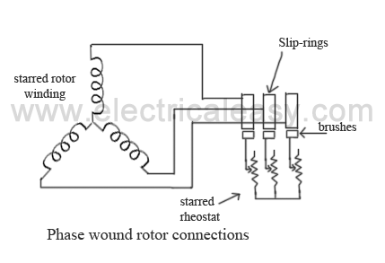
Phase Wound Rotor or slip ring rotor

Slide 3
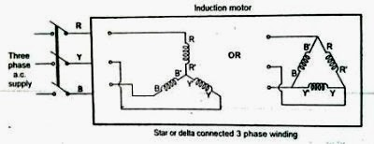
Production of Rotating magnetic field
The stator of an induction motor consists of a number of overlapping windings offset by an electrical angle of 120°. When the primary winding or stator is connected to a three-phase alternating current supply, it establishes a rotating magnetic field which rotates at a synchronous speed.

Slide 4
Slip of a 3 phase induction motor

Slide 5
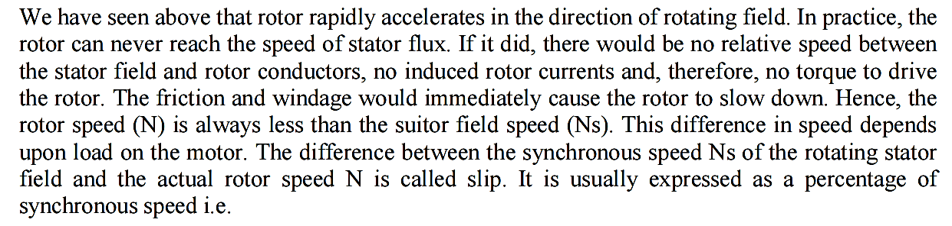
Slip of a 3 phase induction motor

Slide 6
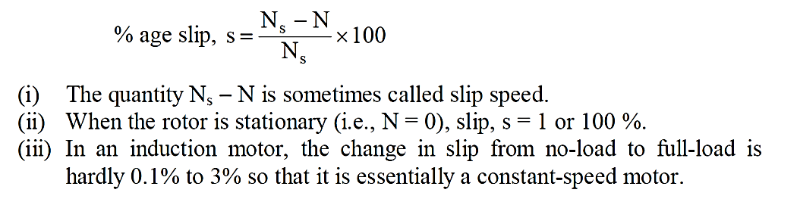
Slip of a 3 phase induction motor

Slide 7
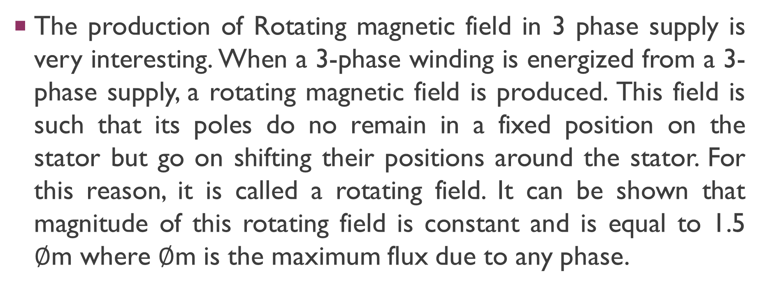
Model-2 : production of Rotating magnetic
The production of Rotating magnetic field in 3 phase supply is very interesting. When a 3-phase winding is energized from a 3-phase supply, a rotating magnetic field is produced. This field is such that its poles do no remain in a fixed position on the stator but go on shifting their positions around the stator. For this reason, it is called a rotating field. It can be shown that magnitude of this rotating field is constant and is equal to 1.5 $∅$m where $∅$m is the maximum flux due to any phase.

Slide 8
Production of Rotating magnetic field
The three phase currents flow simultaneously alternating phase current displaced from each other by 120° electrical. Each alternating phase current produces its own flux which is sinusoidal. So all three fluxes are sinusoidal and are separated from each other by 120°. If the phase sequence of the windings is R-Y-B, then mathematical equations for the instantaneous values of the three fluxes
ΦR , ΦY ,ΦB can be written as,

Slide 9
Production of Rotating magnetic field
ΦR = Φm sin(ωt)
ΦY = Φm sin(ωt - 120)
ΦB = Φm sin(ωt - 240)

Slide 10
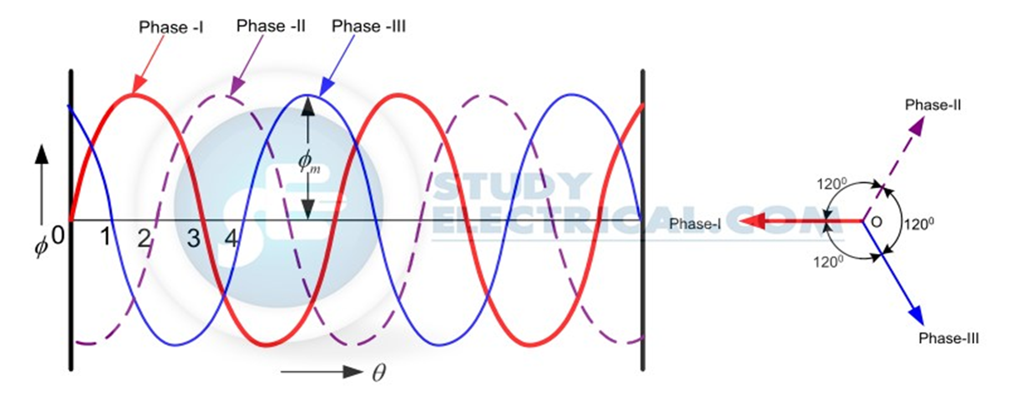
Production of rotating magnetic field

Slide 11
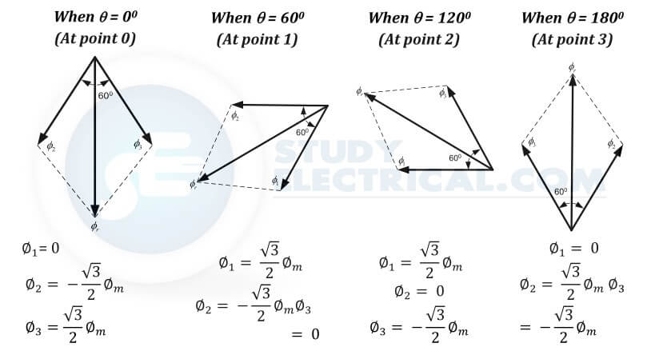

Slide 12
Production of Rotating magnetic field
Case 1 : ωt = 0
ΦR = Φm sin(0) = 0
ΦY = Φm sin(0 - 120) = -0.866 Φm
ΦB = Φm sin(0 - 240) = +0.866 Φm

Slide 13
Production of Rotating magnetic field
Case 2 : ωt = 60
Case-2: ωt = 60
ΦR = Φm Sin(60) = +0.866 Φm
ΦY = Φm Sin(- 60) = -0.866 Φm
ΦB = Φm Sin(- 180) = 0

Slide 14
Production of Rotating magnetic field
Case 3 : ωt = 120
ΦR = Φmsin(120) = +0.866 Φm
ΦY = Φmsin(0) = 0
ΦB = Φmsin(- 120) = -0.866 Φm

Slide 15
Production of Rotating magnetic field
Case 4 : ωt = 180
ΦR = Φmsin(180) = 0
ΦY = Φmsin(60) = +.866 Φm
ΦB = Φmsin(- 60) = -0.866 Φm

Slide 16
Principle of operation
Work on the principle of Electromagnetic Induction

Slide 17
Principle of operation
RMF produces the effect of rotating poles around a rotor.
Relative motion between RMF and Rotor conductor
Force exerts on rotor, hence it rotates
Induces EMF in Rotor conductors-Electromagnetic induction.

Slide 18

Speed of rotating magnetic field
$Ns=\frac{120f}{p}$

Slide 19
Direction of RMF
Depends on Phase sequence
Phase sequence can be reversed by interchanging any 2 terminals
Direction of rotation of motor can be changed by changing phase sequence

Slide 20
Torque Equation of Three Phase Induction Motor
The torque produced by three phase induction motor depends upon the following three factors:
Firstly the magnitude of rotor current,
secondly the flux which interact with the rotor of three phase induction motor and is responsible for producing emf in the rotor part of induction motor,
lastly the power factor of rotor of the three phase induction motor.

Slide 21
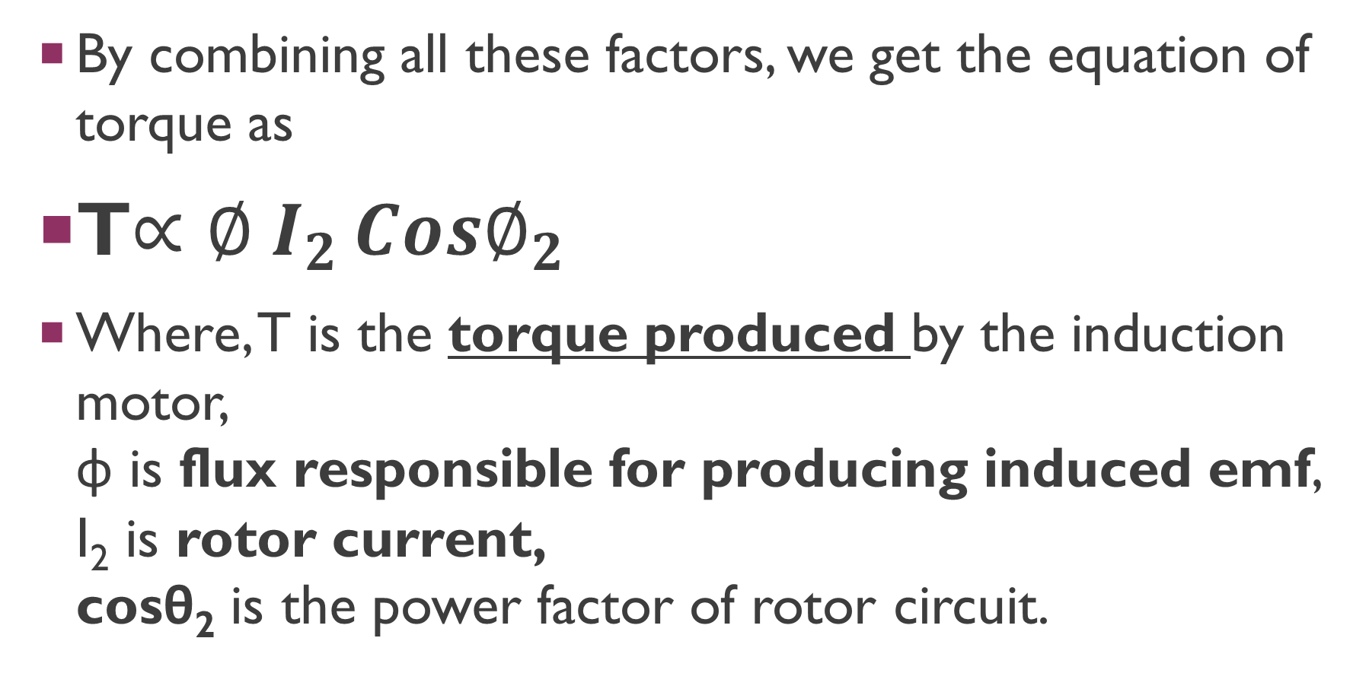
Torque Equation of Three Phase Induction Motor
By combining all these factors, we get the equation of torque as
T$∝∅ {I_{2 }Cos∅}_{2}$
Where, T is the torque produced by the induction motor, φ is flux responsible for producing induced emf, I₂ is rotor current, cosθ₂ is the power factor of rotor circuit.

Slide 22
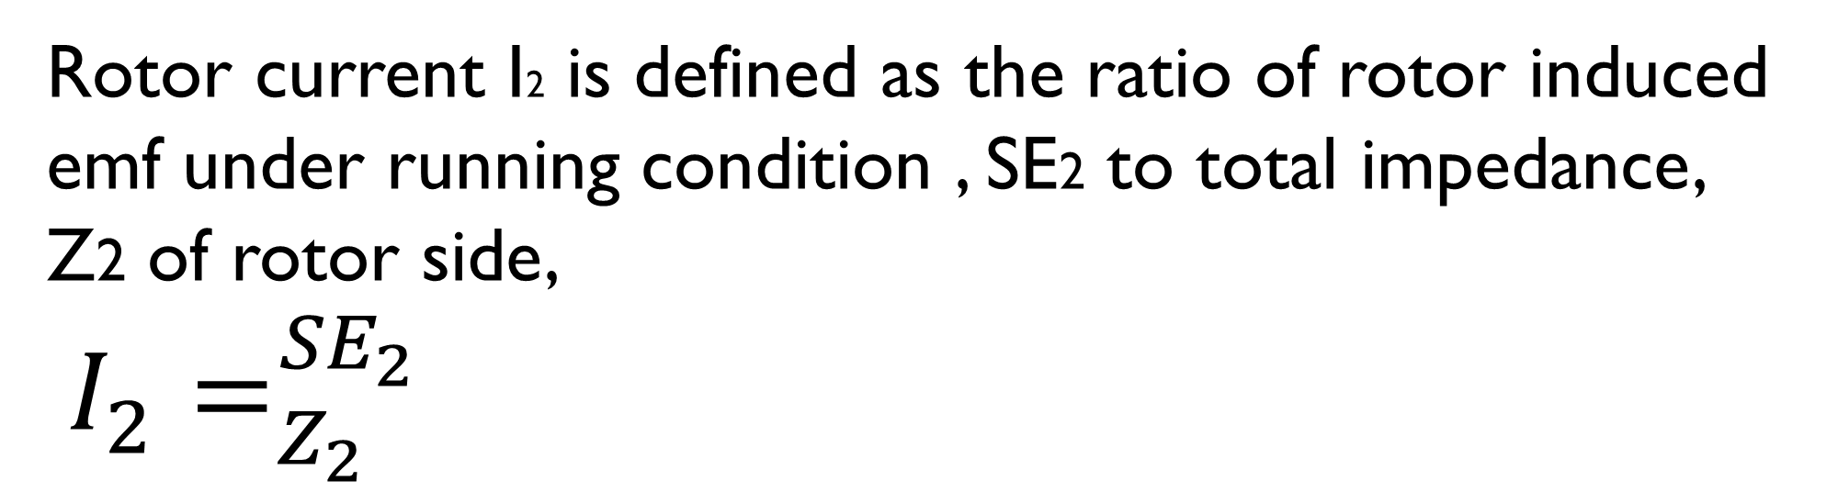
φ ∝ E2
Rotor current I2 is defined as the ratio of rotor induced emf under running condition , SE2 to total impedance, Z2 of rotor side,
${I_{2}=}_{Z_{2}}^{{SE}_{2}}$
and total impedance Z2 on rotor side is given by ,

Slide 23







Where, n_{s} is synchronous speed in r. p. s, n_{s} = N_{s} / 60. So, finally the equation of torque becomes,

Slide 24
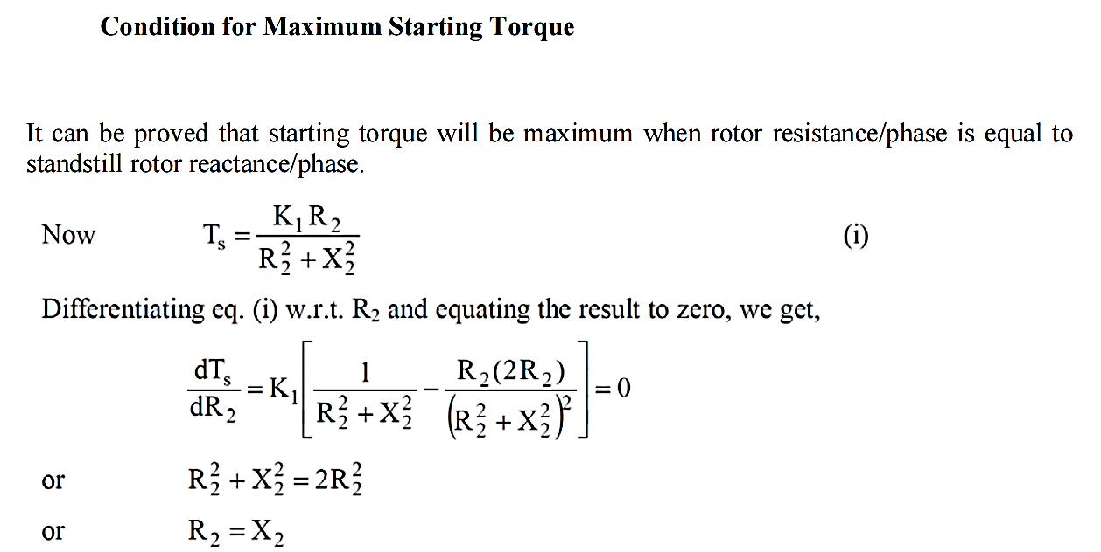
Condition for maximum torque

Slide 25
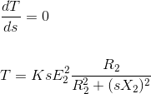

So, when slip s = R2 / X2, the torque will be maximum and this slip is called maximum slip Sm and it is defined as the ratio of rotor resistance to that of rotor reactance.

Slide 26
From the above equation it is concluded that
The maximum torque is directly proportional to square of rotor induced emf at the standstill.
The maximum torque is inversely proportional to rotor reactance.
The maximum torque is independent of rotor resistance.
The slip at which maximum torque occur depends upon rotor resistance, R2. So, by varying the rotor resistance, maximum torque can be obtained at any required slip.

Slide 27
There are mainly two types of Induction Motor:
Squirrel Cage Induction Motor and
Slip Ring or Wound Rotor Induction Motor.
This classification is based on the constructional difference between them. On the basis of kind of power supply, there are again two types: Single Phase and Three Phase.

Slide 28
Construction:stator
The stator of a 3 phase IM (Induction Motor) is made up with number of stampings, and these stampings are slotted to receive the stator winding.
The stator is wound with a 3 phase winding which is fed from a 3 phase supply.
It is wound for a defined number of poles, and the number of poles is determined from the required speed.
For greater speed, lesser number of poles is used and vice versa.

Slide 29
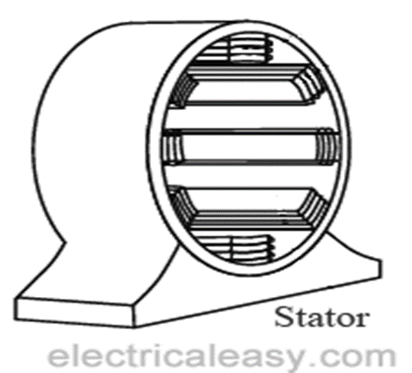
Stator of a 3 phase IM

Slide 30
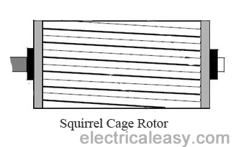
Rotor: Squirrel cage Rotor

Slide 31
Rotor: Squirrel cage Rotor
Most of the induction motors (up to 90%) are of squirrel cage type.
Squirrel cage type rotor has very simple and almost indestructible construction.
This type of rotor consist of a cylindrical laminated core, having parallel slots on it.
These parallel slots carry rotor conductors.
In this type of rotor, heavy bars of copper, aluminum or alloys are used as rotor conductors instead of wires.

Slide 32
Rotor: Squirrel cage Rotor
Rotor slots are slightly skewed to achieve following advantages -
1. it reduces locking tendency of the rotor, i.e. the tendency of rotor teeth to remain under stator teeth due to magnetic attraction.
2. increases the effective transformation ratio between stator and rotor
3. increases rotor resistance due to increased length of the rotor conductor
The rotor bars are brazed or electrically welded to short circuiting end rings at both ends.
Thus this rotor construction looks like a squirrel cage and hence we call it.
The rotor bars are permanently short circuited, hence it is not possible to add any external resistance to armature circuit.

Slide 33
Phase Wound Rotor:slipring rotor

Slide 34
Phase Wound Rotor:slipring rotor
Phase wound rotor is wound with 3 phase, double layer, distributed winding. The number of poles of rotor are kept same to the number of poles of the stator.
The three phase rotor winding is internally star connected.
The other three terminals of the winding are taken out via three insulated sleep rings mounted on the shaft and the brushes resting on them.
These three brushes are connected to an external star connected rheostat.
This arrangement is done to introduce an external resistance in rotor circuit for starting purposes and for changing the speed / torque characteristics.

Slide 35
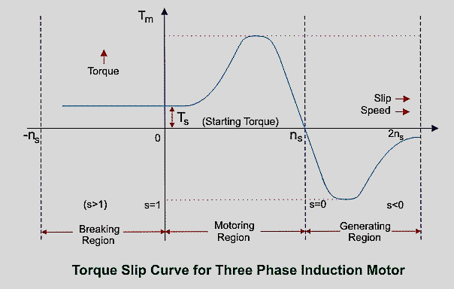
Torque slip[p characteristics of 3phase induction motor

Slide 36
Torque slip[p characteristics of 3phase induction motor
The torque slip curve for an induction motor gives us the information about the variation of torque with the slip. The slip is defined as the ratio of difference of synchronous speed and actual rotor speed to the synchronous speed of the machine. The variation of slip can be obtained with the variation of speed that is when speed varies the slip will also vary and the torque corresponding to that speed will also vary.

Slide 37
Torque slip[p characteristics of 3phase induction motor
Motoring Mode: In this mode of operation, supply is given to the stator sides and the motor always rotates below the synchronous speed.
The induction motor torque varies from zero to full load torque as the slip varies.
The slip varies from zero to one.
It is zero at no load and one at standstill.
From the curve it is seen that the torque is directly proportional to the slip.
That is, more is the slip, more will be the torque produced and vice-versa.

Slide 38
Torque slip[p characteristics of 3phase induction motor
Generating Mode:
In this mode of operation induction motor runs above the synchronous speed and it should be driven by a prime mover. The stator winding is connected to a three phase supply in which it supplies electrical energy.
Actually, in this case, the torque and slip both are negative so the motor receives mechanical energy and delivers electrical energy.
Induction motor is not much used as generator because it requires reactive power for its operation.
That is, reactive power should be supplied from outside and if it runs below the synchronous speed by any means, it consumes electrical energy rather than giving it at the output. So, as far as possible, induction generators are generally avoided.

Slide 39
Torque slip[p characteristics of 3phase induction motor
Braking Mode: In the Braking mode, the two leads or the polarity of the supply voltage is changed so that the motor starts to rotate in the reverse direction and as a result the motor stops. This method of braking is known as plugging.
This method is used when it is required to stop the motor within a very short period of time.
The kinetic energy stored in the revolving load is dissipated as heat.
Also, motor is still receiving power from the stator which is also dissipated as heat.
So as a result of which motor develops enormous heat energy.
For this stator is disconnected from the supply before motor enters the braking mode.

Slide 40
Generative braking
If load which the motor drives accelerates the motor in the same direction as the motor is rotating, the speed of the motor may increase more than synchronous speed.
In this case, it acts as an induction generator which supplies electrical energy to the mains which tends to slow down the motor to its synchronous speed,
in this case the motor stops. This type of breaking principle is called dynamic or regenerative breaking.

Slide 41
3 phase induction machine
Torque equation
Slip and its significance
Torque slip characteristics
various losses that occur in an induction motor and vary with frequency, voltage and load

